Slide 1
Website Development Basics with PHP MySQL
CMP283 Database Management
Sabahattin Gokhan Ozden
www.gokhanozden.com
April 18, 2017

Slide 2
Learning Outcomes
How to setup a PHP MySQL development environment on a computer
How to create database using PHPMyAdmin.
How to create tables using PHPMyAdmin.
How to add records using PHPMyAdmin.
How to create a simple PHP page to show records.
How to modify the page so it shows certain records using GET method.
How to create a simple form to add records to database using POST method.
How to update those records.

Slide 3
What Not to Expect from This Class
Website Design Basics (Photoshop, CSS, etc.)
Search Engine Optimization
Database Modeling (Normalization, Primary Key, JOINs, etc.)

Slide 4
Agenda
PHP (php.net)
MySQL (mysql.com)
Environment Setup (WinLAMP- Windows, MAMP – MacOS, Windows)
PhpMyAdmin (comes with WinLAMP)
Web Based Personal Address Book (http://www.hosting.vt.edu/tutorials/phpmysql/)
Database Design of the System
Accessing and Manipulating Data with PHP
http://winlamp.sourceforge.net/
mamp.info/

Slide 5
PHP
PHP stands for “Personal Home Page”
Server side scripting language designed for web development
Created by Rasmus Lerdorf in 1994
It can be embedded into HTML or HTML5
The code is processed by a PHP interpreter
<? echo “Hello World”; ?>
<!DOCTYPE html> <html> <head> <title>First PHP</title> </head> <body><?php echo '<p>Hello World</p>'; ?></body> </html>

Slide 6
MySQL
Open source relational database management system
LAMP (Linux, Apache, MySQL, Perl/PHP/Python), WAMP (Windows), MAMP (MacOS)
Used by WordPress, phpBB, Drupal, Joomla, Google (not for search), Facebook, Twitter, Flickr, Youtube, Verizon.

Slide 7
PHP MySQL
Source: wikipedia.org

Slide 8
Let’s Practice
http://tutorialspoint.com/php_mysql_online.php

Slide 9
Variables
<?php
$a = 1;
$b = 2;
// add two values and output the result
echo $a+$b;
?>

Slide 10
IF Statements
<?php
$age = 18;
$inUSA = true;
if ($age < 21 && $inUSA) {
echo "Sorry, you can't drink in the US.<br>";
echo "How about a trip to Europe?";
}
?>

Slide 11
IF Statements (Exercise)
Legal age calculator
You input your age and it tells you what you can and you can’t do with respect to legal driving age (16), voting age (18), and legal drinking age (21).
For example if you enter 17 it will output:
You can drive legally.
You can’t vote.
You can’t drink legally.

Slide 12
Loops
<?php
for ($number=1; $number <= 1000; $number++) {
echo $number," ";
if ($number/2 == floor($number/2)) { echo "even"; }
else { echo "odd"; }
echo "<br>";
}
?>

Slide 13
Loops (Exercise)
Calculate the summation of numbers from 1 to 10
Hint: Summation should be equal to 55

Slide 14
Loops (Exercise) – A solution
<?php
// for loop
$n = 10;
$sum = 0;
// sum of n natural numbers
for ($i = 1;$i <= $n;$i++) {
$sum+= $i;
}
echo ($sum);
?>

Slide 15
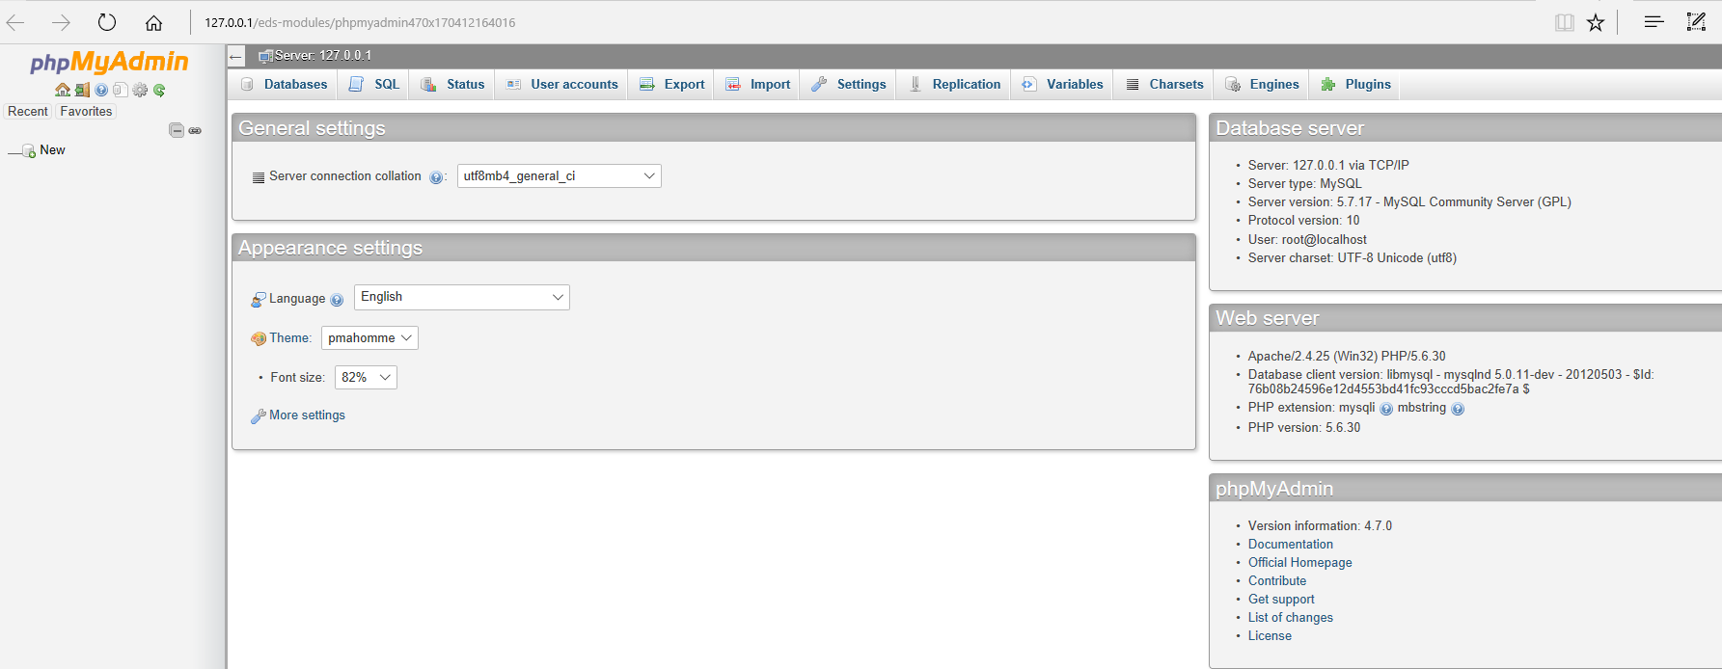
PHPMyAdmin
Open source GUI written in PHP to design and manipulate databases in MySQL.
Create, modify, delete databases, tables, fields, or rows, manage users and permissions in a web browser.

Slide 16
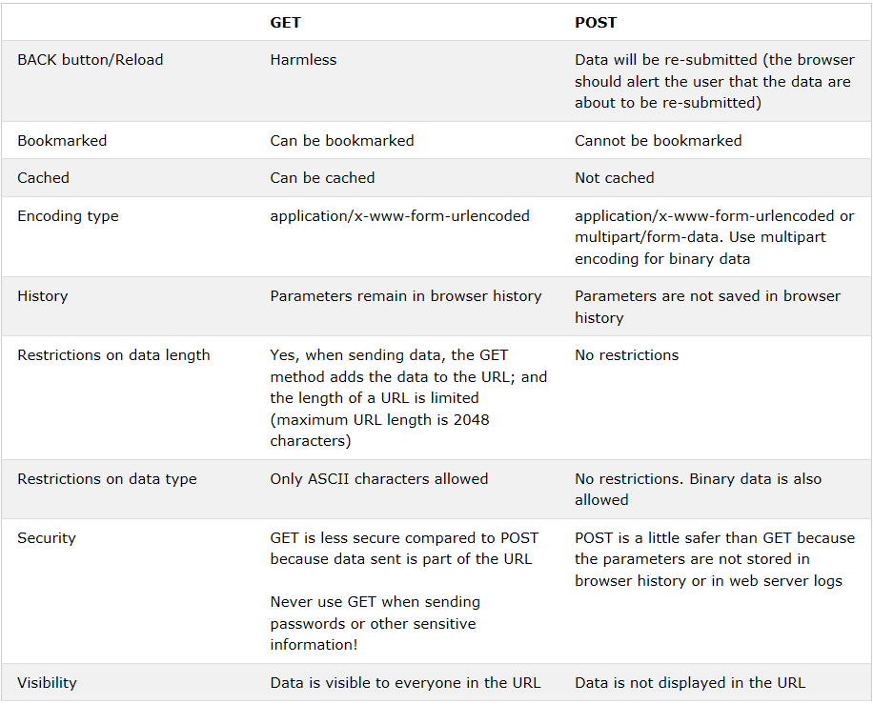
GET vs. POST methods
Source: https://www.w3schools.com/tags/ref_httpmethods.asp

Slide 17
SQL Injection
SQL Injection is an injection attack where an attacker can execute malicious SQL statements that control a web application’s database server.
Attacker can bypass web application’s authentication and authorization mechanisms.
Attacker can retrieve the contents of an entire database.
Attacker can add, modify, and delete records.
More info: https://www.acunetix.com/websitesecurity/sql-injection/

Slide 18
An Address Book

Slide 19
Five PHP Scripts
dbconnect.php (Connects to the database)
listcontacts.php (queries the database for all names, outputs a table with all data including edit and delete links which contain the record-ID as a parameter, the delete link is intercepted by a JavaScript confirmation message)
addcontact.php (Has an input form, it submits to itself, validates if first name or last name empty, if data is complete then it is added to database)
editcontact.php (Very similar to addcontact.php, but the form is prefilled with the data already in database, gets the unique record with the “$id” variable which is passed to it by the edit link in listcontacts.php, when the form is submitted it validates and updates the record instead of inserting a new one.
deletecontact.php (this does not have a visible HTML page, it gets the record id from listcontacts.php and deletes the record and returns back to listcontacts.php)
These scripts can be download from http://www.gokhanozden.com/guest-lecturer-at-chatham-university/

